Slide 1

Software Development Methodologies - Introduction
Overview of this session
Time line of different methodologies
Focus on main sequential and interactive examples: Waterfall and Scrum
“fun” exercise to illustrate strengths and weaknesses of each approach
Overview of next session
Mention the other methodologies (including a made up one)
“fun” quiz to recap and reinforce what we have learnt

Slide 2
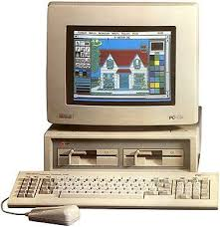





Software Development Methodologies* – All pretty similar
All the methodologies implement the same SDLC stages, but with different emphasis and order.
People have been making new ones for a while, and will continue to in the future.
Disclaimer: All views are my own and some have just been made up. Do not blindly trust me! Stop and ask questions at any point, and google it all afterwards to check I was not lying to you.
RAD
SCRUM
XP
DevOps
LeSS
TDD
Somethings new
Waterfall
Spiral
DSDM
RUP
Kanban
SAFe
Something else
LEAN
1970
1980
1990
2000
2010
2020
2030
*Syllabus talks about methodologies and methods as different things. But I not sure I agree on the difference.

Slide 3



Software Development Methodologies – Why bother?
Why do we need Methodologies?
Why don’t we just use the Nike methodology (aka “Just do it”)
Just coding it up does not work when scale or complexity increases. It does not encourage quality or predictability. It does not aid communication.
Nike
Scrum
Waterfall or SAFe
(personal use)
(medium scale)
(industrial scale)

Slide 4
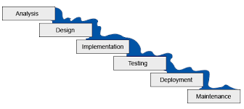
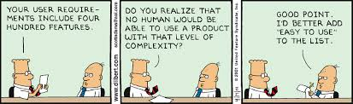
Software Development Methodologies - Waterfall
“Invented” in 1970
Sequential - text book example
Predictable
Rigorous
Document heavy
Unresponsive to change

Slide 5
Software Development Methodologies - Waterfall
Analysis
Understand requirements
Feasibility study (cost, time, non-functional requirements)
Write functional spec
Write high level design doc
Design
Write detailed design doc
Implementation
Write code/implement design
Testing
Write test specs
Manually run Integration tests
Manually run Factory Acceptance Tests (FAT)
Manually run User Acceptance Tests (UAT)
Deployment
Manually install?
Maintenance
Fix all the bugs?

Slide 6




Software Development Methodologies - Waterfall
Requirements Spec
Requirements gathering done by “customer” before starting.
Each stage produces documents for the next stage!
“developers” only needed during implementation stage
Tests all done at end of dev!
Integration Testing
Functional Spec
FAT
UAT
Get paid?
Design Spec
Test Spec
Legally binding document?
User Guide

Slide 7
Software Development Methodologies - Waterfall
Pros
Unfeasible projects should get stopped in analysis stage
Well defined problems can be thoroughly “designed up front”
Changing team members has less affect due to reliance on documentation
Obvious milestones, easy to measure progress?
Cons
“analysis paralysis” possible – complicated problems can stay in analysis stage for a long time
Poorly defined problems will produce the wrong solution
Bugs may not become apparent until the test or deployment stage

Slide 8
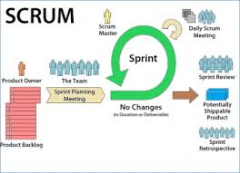
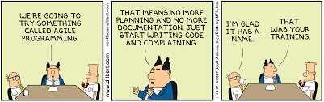
Software Development Methodologies - Scrum
You know all about this already from last bootcamp!
Iterative and Agile – text book example
Backlog rather than Requirements spec
“Sprint zero” to create and prioritize backlog and do analysis and feasibility
Each subsequent sprint contains refinement(analysis), development, test, deployment, and review/demo
Allows feedback and encourages improvement
Contains “team members” rather than developers and testers

Slide 9
Software Development Methodologies - Scrum
Pros
Can produce product quickly
Allows rapid feedback and improvement
Ideal for small ill defined problems
Rewarding for team members?
Cons
Allows scope creep (is this bad?)
No deadline?
Not suited to large teams
Not suited to complex problems?
Requires dedicated team members
Requires engaged customers
Requires commitment to quality
Analysis and feasibility may get de-emphasized?

Slide 10

Software Development Methodologies – Questions?

Slide 11
Software Development Methodologies

